Slide 1
Patient, Involved Investors Encourage Entrepreneurial Ecosystem
Grand Angels®

Slide 2
What is angel investing?
Who are angel investors?
What is Grand Angels?
What has Grand Angels accomplished?

Slide 3
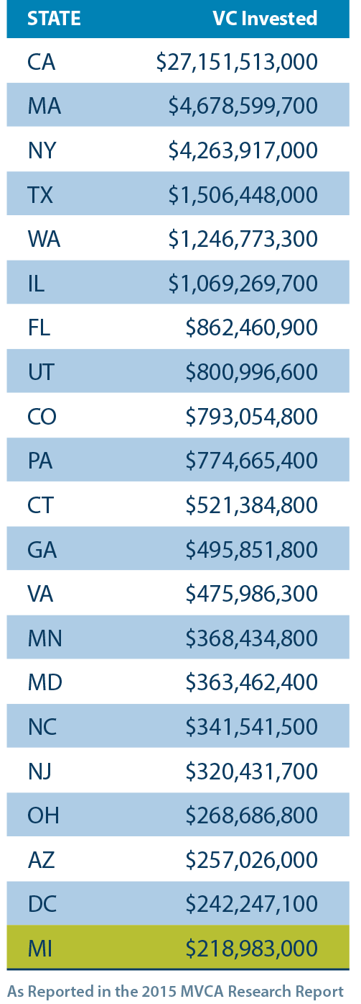
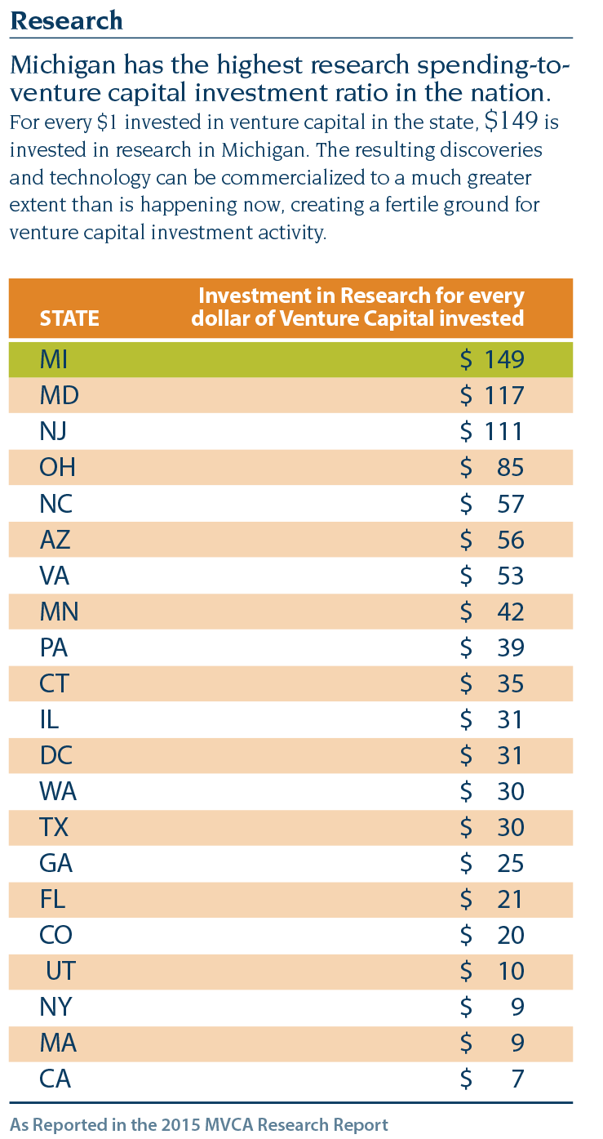
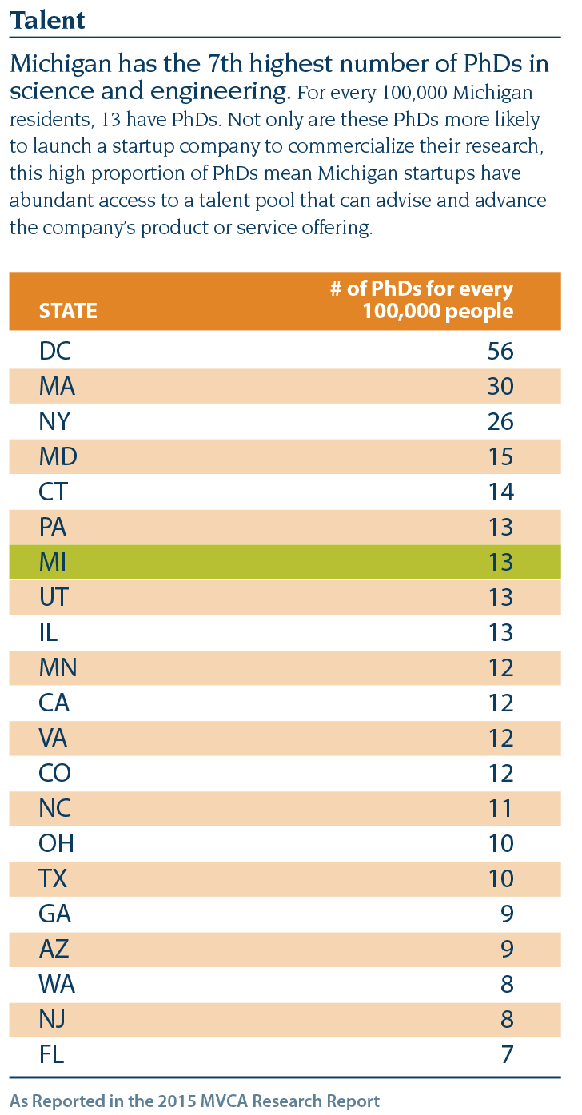
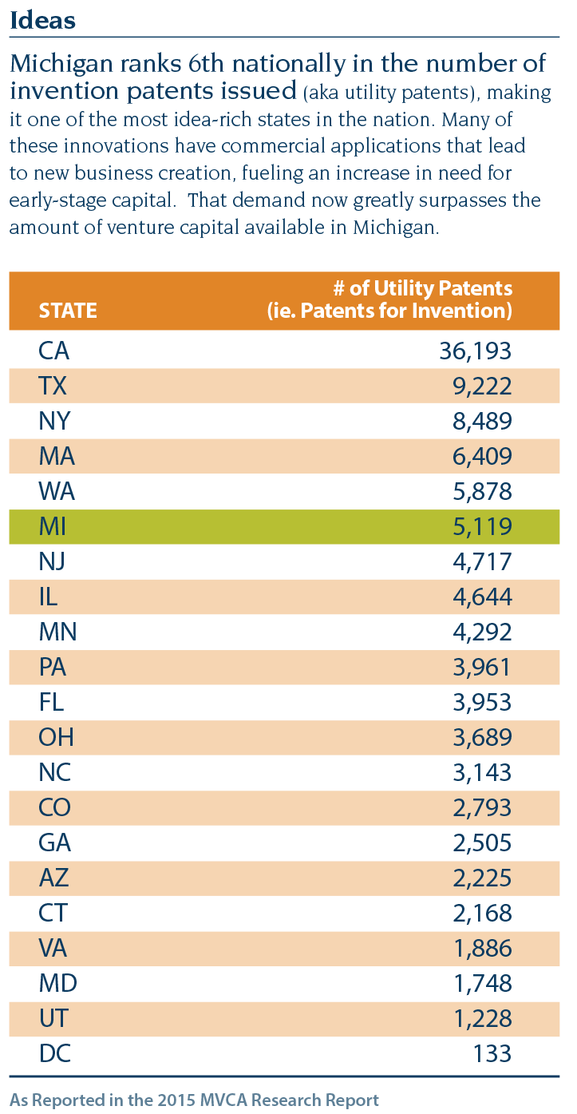

Slide 4
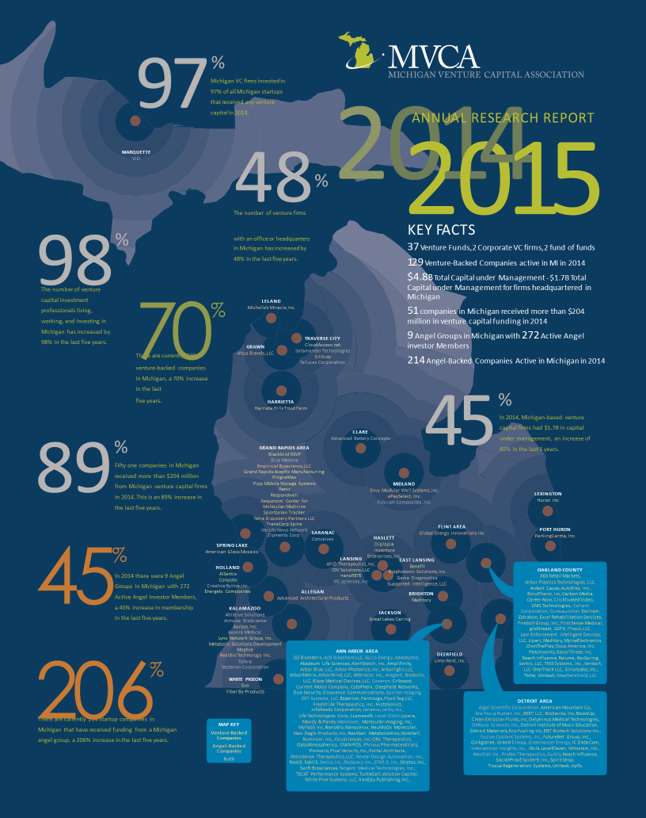

Slide 7
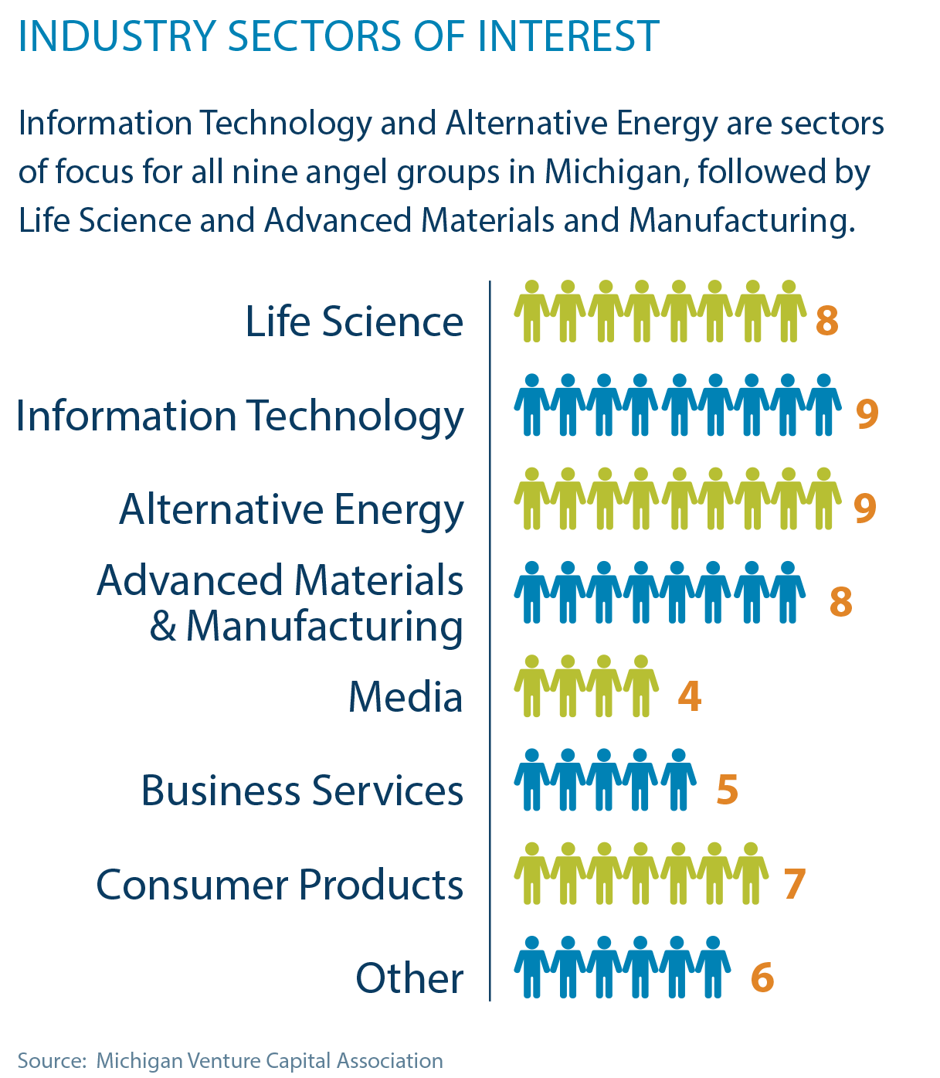

Slide 8
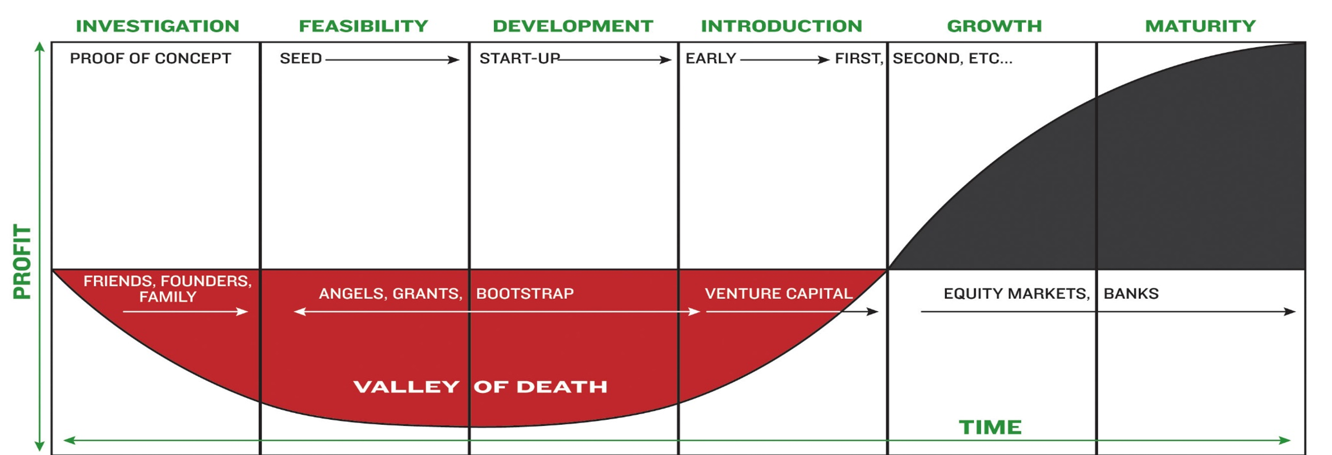
The Capital Lifecycle

Slide 9
The Center for Venture Research 2014 Data
Number of Angels in U.S. | 316,000
$ invested in U.S. | $24.1 billion

Slide 10
Solo Angels
Process is time-consuming
Deal sourcing
Reading plans
Due diligence
Due diligence is difficult
Finding vertical experience
May require using outside experts
Legal support is expensive

Slide 11
Investing through Angel Groups
Dividing the work eases the pain
Variety of vertical experience available
Standardized processes and term sheets
Deal flow encouraged, entrepreneur-friendly
Pick and choose the deals you like
Great camaraderie among the like-minded

Slide 12
Expected Returns
10-20% | Home Runs
30-40% | Singles or Doubles
50% | Unsuccessful

Slide 13
Grand Angels Statistics
HOW WE COMPARE 2004-2015
Average $ invested per company $533,690.40
Average $ per round $209,878.24
Average $ per year $1.62M
Rounds per year 7.7
Investors per round 7.8
New deals 42%
Follow-on rounds 58%
Total invested (2004-2015) $19,037,911
NATIONAL ANGEL STATISTICS Q1Q2 2014
Average $ invested per deal $332,120.00
Average investors per deal 4-5
Average proposals presented 9
Average successful deals 2
Average new deals 50%
Average follow-on rounds 50%
(Source: Center for Venture Research)

Slide 14
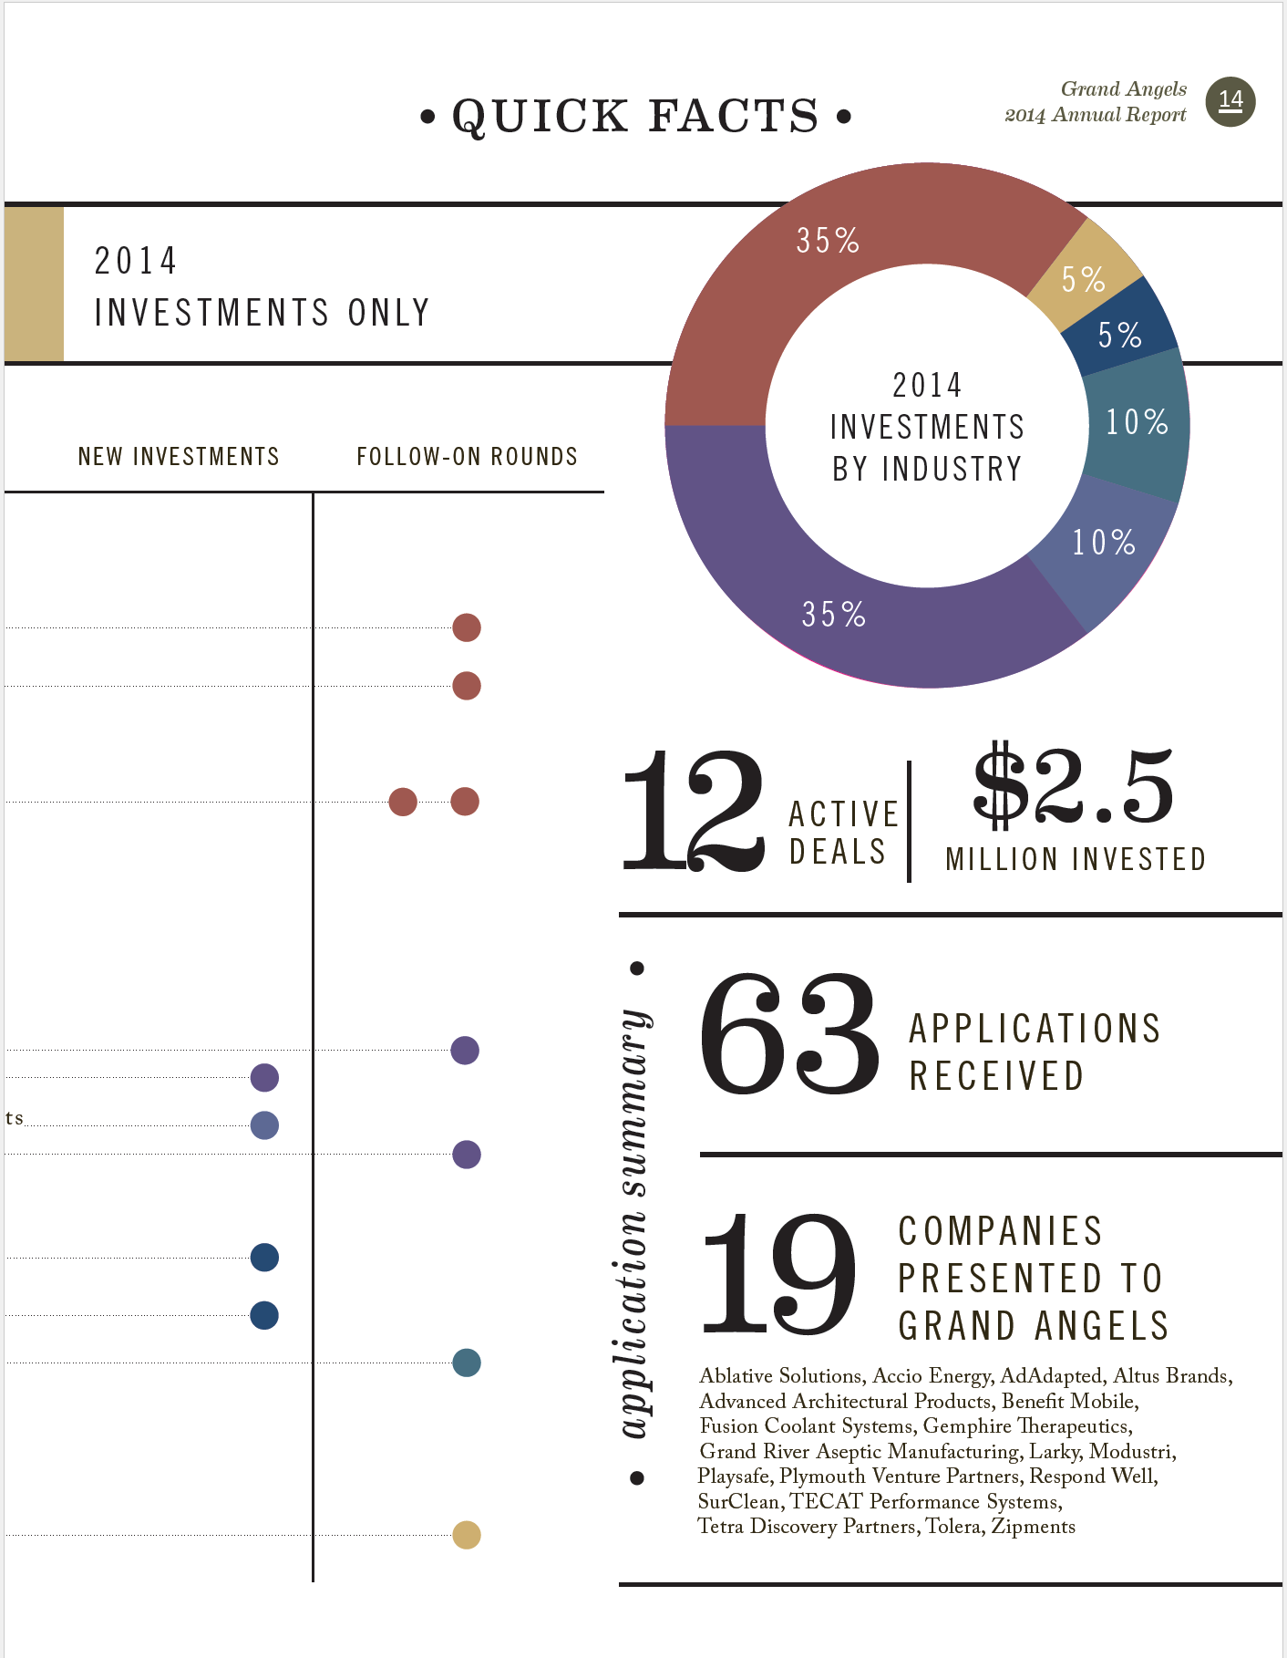

Slide 15
Grand Angels® PORTFOLIO COMPANIES - 2015

Slide 19
Grand Angels®
Grand Angels
36 W. 8th Street, Suite 200
Holland, MI 49423
Ph. (616) 566-1770
www.grandangels.org

